Slide 1
WellBot – System Architecture Overview.
AI-Based Wellness Chatbot System.
Presented by:
Sakshi Zade

Slide 2
Architecture Highlights
main components
Flask Backend
OpenAI GPT-3.5
Safety Filter
MongoDB

Slide 3
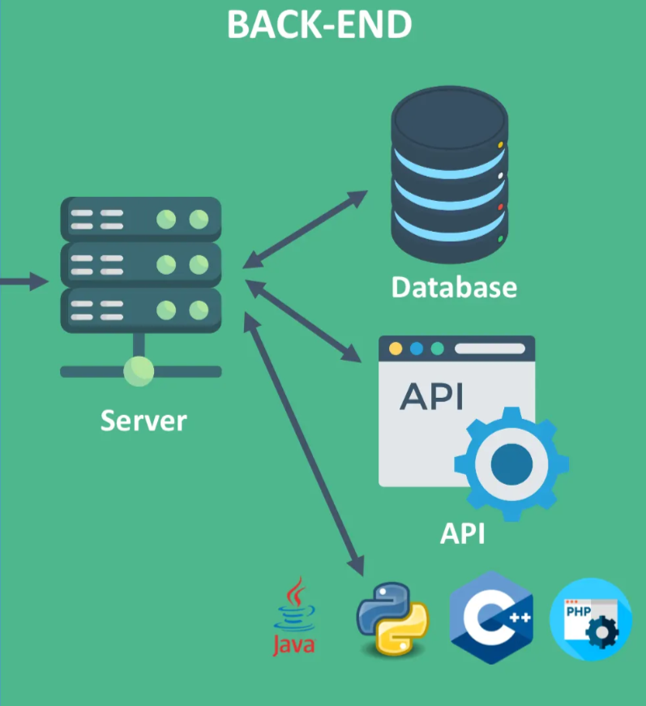
Backend Layer
Flask framework for API management
RESTful APIs for communication
Middleware for authentication and safety checks
Flask framework for API management.
• Error handling & logging system.

Slide 4
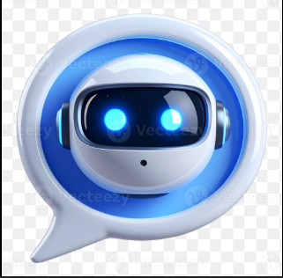
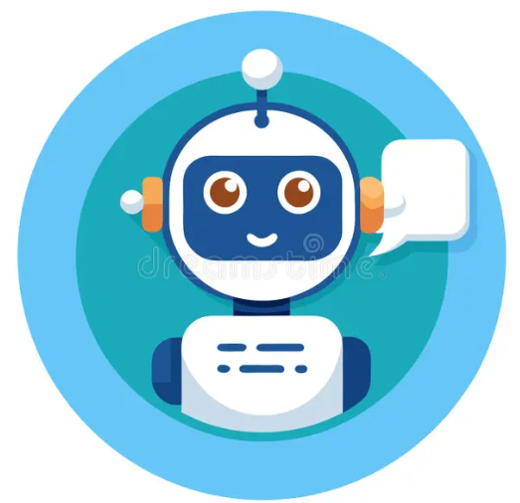
AI Core
GPT-3.5 for natural language understanding.
Empathetic response generation.
Crisis keyword detection.
Context-aware conversation memory.

Slide 5
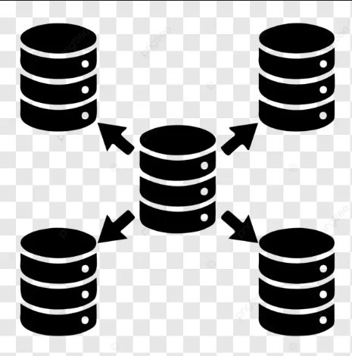
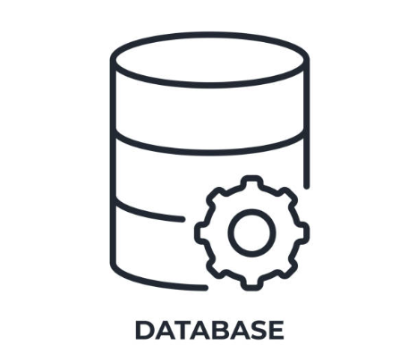
Database Layer
MongoDB for chat logs, profiles, mood tracking.
Document-based storage for flexibility.
Optimized queries for fast retrieval.
Backup & recovery mechanisms.

Slide 6
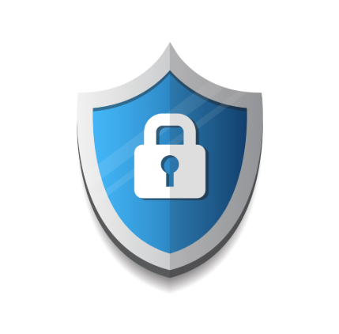
Security & Safety
Google OAuth for authentication.
SHA-256 hashing for sensitive data.
Crisis detection integrated.
Role-based access control (RBAC).

Slide 7
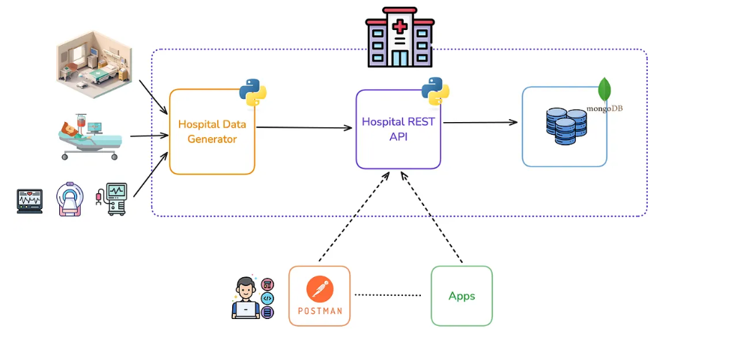
System Flow Diagram
User
Frontend (UI)
Flask Backend
AI Core (GPT + Safety Filter)
Database (MongoDB).
Flow of information:
User sends a message.
2.Frontend passes it to Flask Backend.
Safety Filter checks the content.
GPT-3.5 generates a response.
MongoDB saves the chat and updates mood/stress logs.
This cycle repeats every time the user interacts.

Slide 8
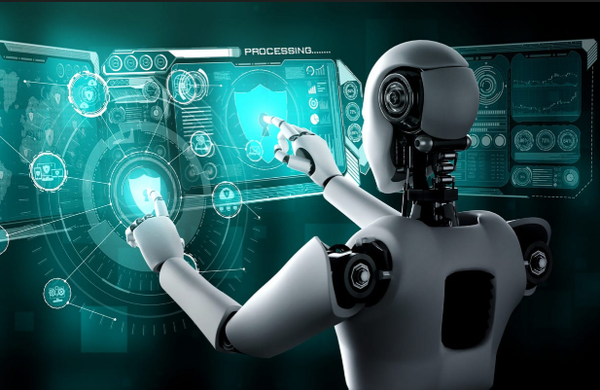
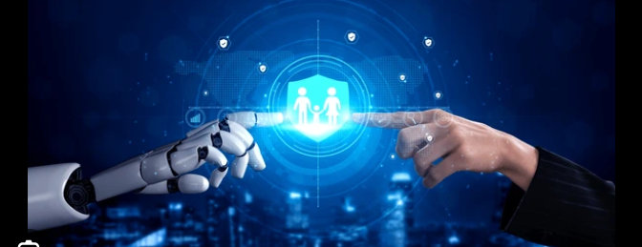
Conclusion
Modular, scalable, secure architecture.
Empathetic, real-time wellness support.
Balances AI intelligence with user safety.
Future-ready for integration with mobile apps.

Slide 9
Thank you

